Slide 1
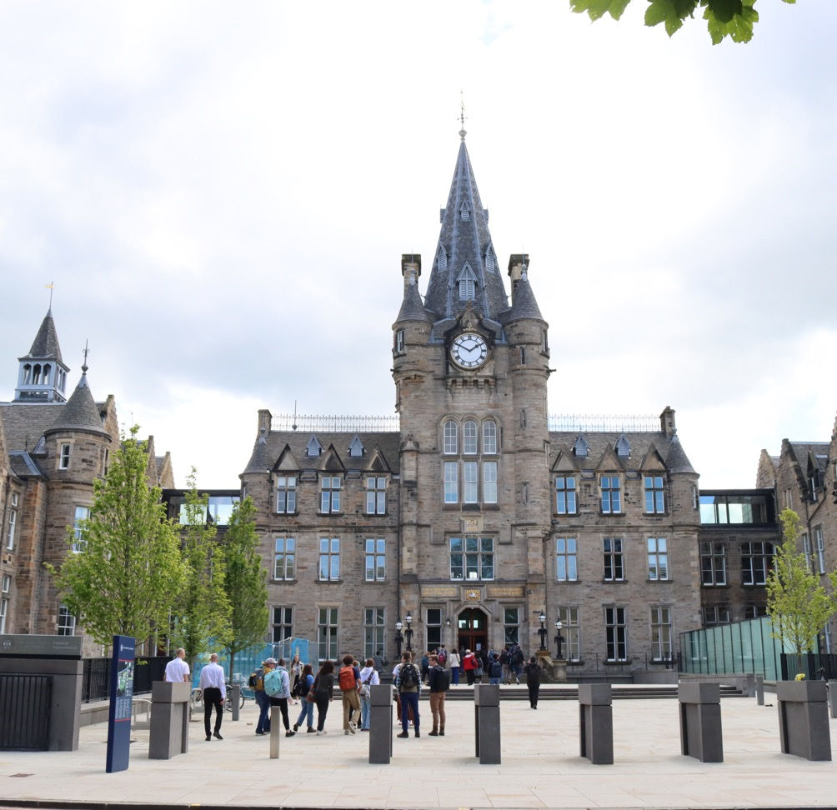
Text Analysis and the Humanities
Lucia Michielin, Digital Skills Training Manager

Slide 2
Our Plan for today
Analysis & Visualisation
Our Dataset & Python Demo

Slide 3

Analysis
Keyword Search/Term Frequency – Counts the occurrences of a specific word within a document
Inverse Document Frequency (TF-IDF) – Measure that assesses how crucial a word is to a document within a corpus, reducing the weight of commonly used words
Key-word in Context (KWIC) – Displays occurrences of a specific word alongside its surrounding words, offering insights into the usage and context of the word within the document.
Bigrams & Ngrams – Refers to sequences of two (bigrams) or 'n' (ngrams) consecutive words used for statistical analysis of text patterns, capturing more contextual information than single-word analysis.
Collocation Analysis – Analyses the frequency and tendency of pairs or groups of words appearing close together more often than by chance, identifying commonly co-occurring terms and phrases.

Slide 4
Advanced Techniques
Part of Speech tagging – identify language structures (More info here, try it here)
Named entity recognition (NER) –to find people, places, organizations, etc. (More info here)
Topic modelling – unsupervised Machine Learning technique to identify topics in large corpus (video introduction/examples here)
Word embedding – to study meanings and how word relate to each others (Try it out here)
Classification – e.g. Sentiment analysis, each word is associated with a +/- value (try it out here)

Slide 5
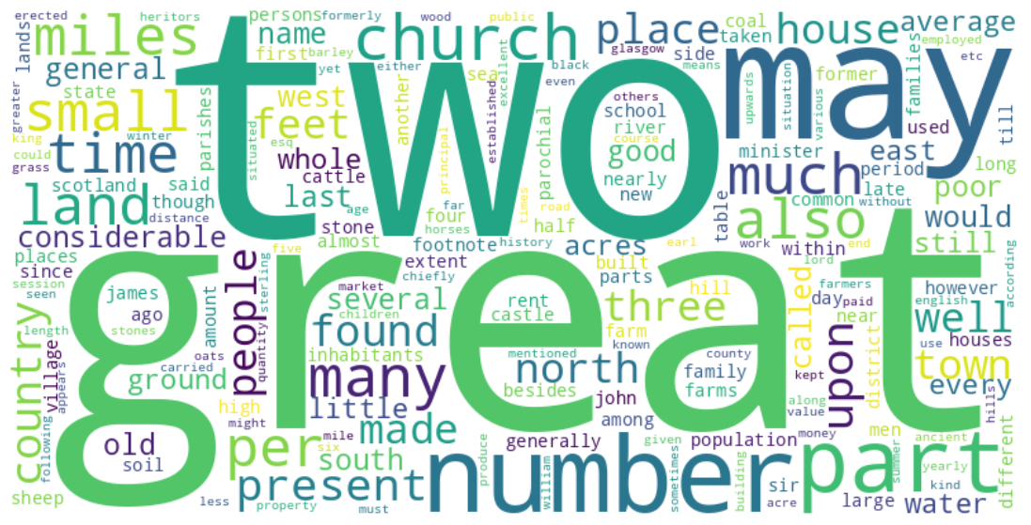
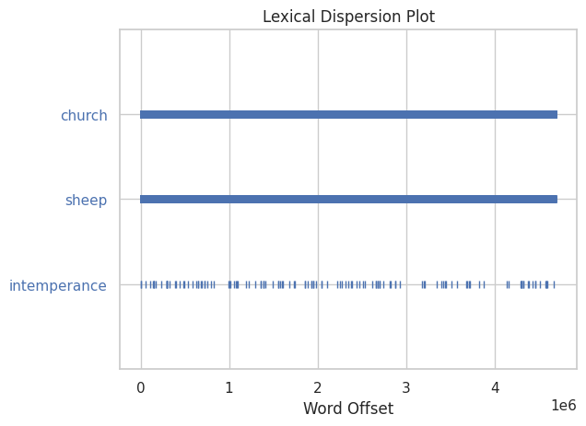
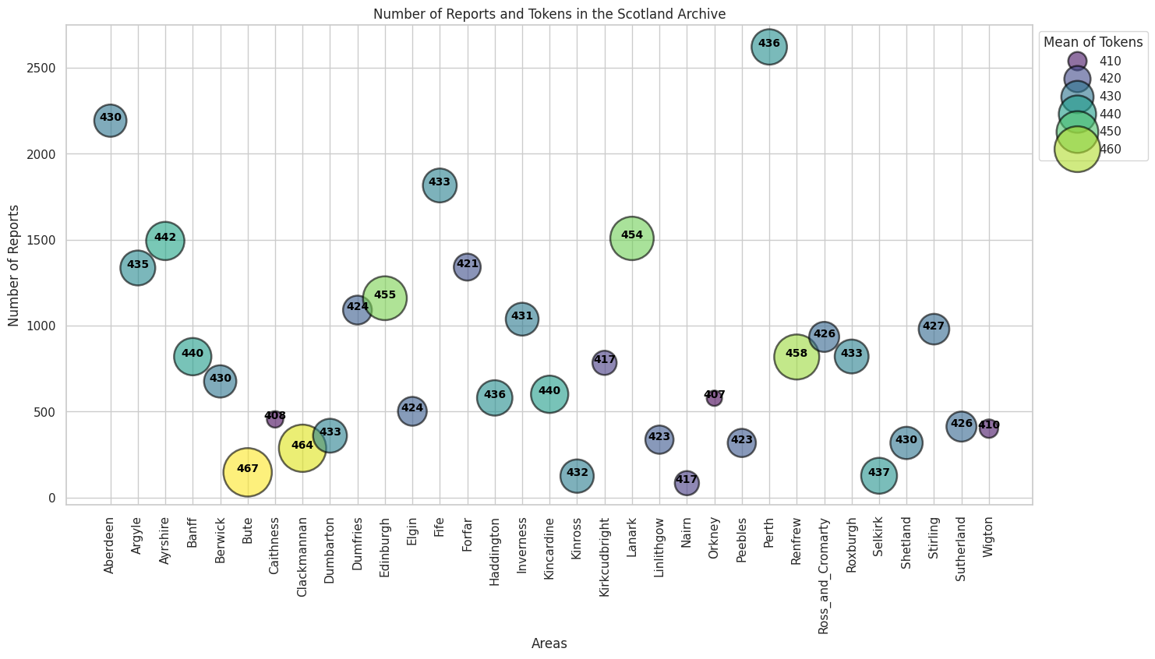
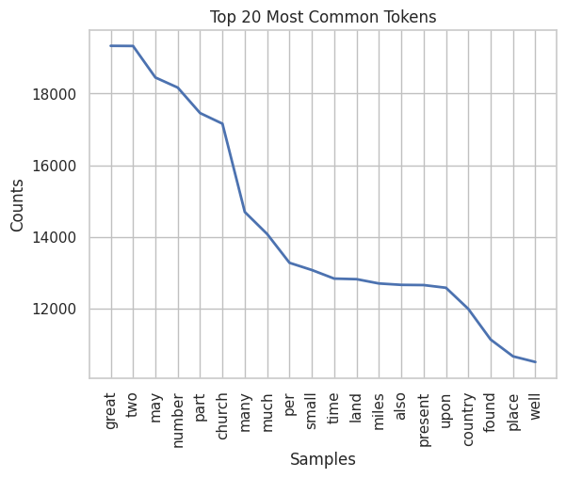
Visualisation
Standard visualisations
Explore dataset
Word-cloud
Frequency plots
Dispersion Plots

Slide 6
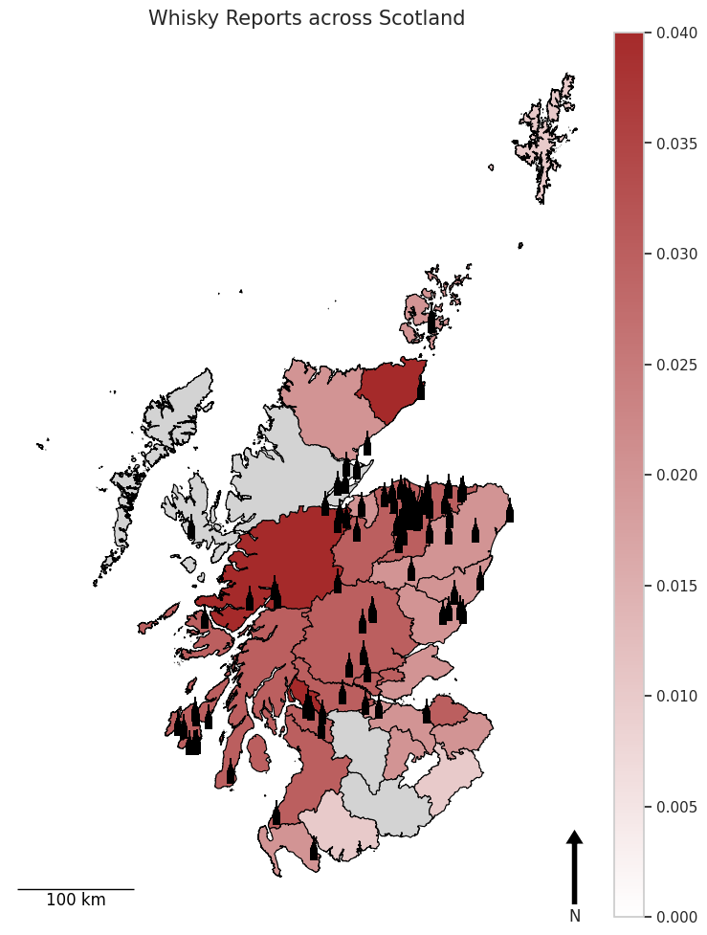
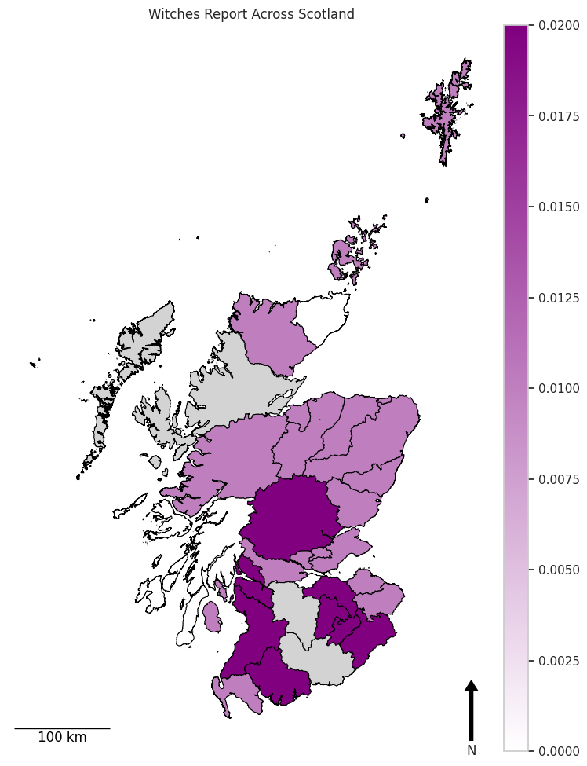
Visualisation
Advanced visualisation
Geographical plots
More artistic outputs

Slide 7
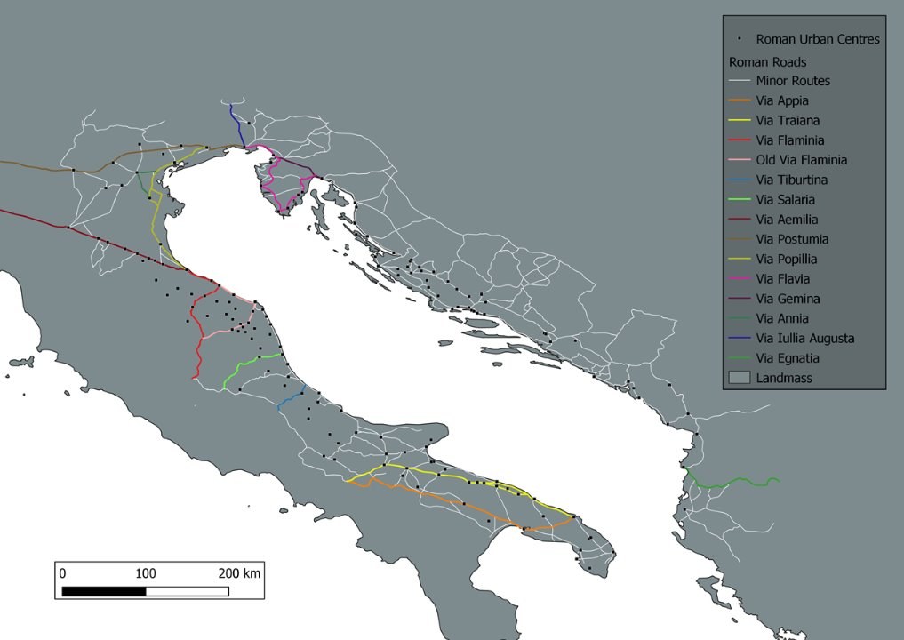
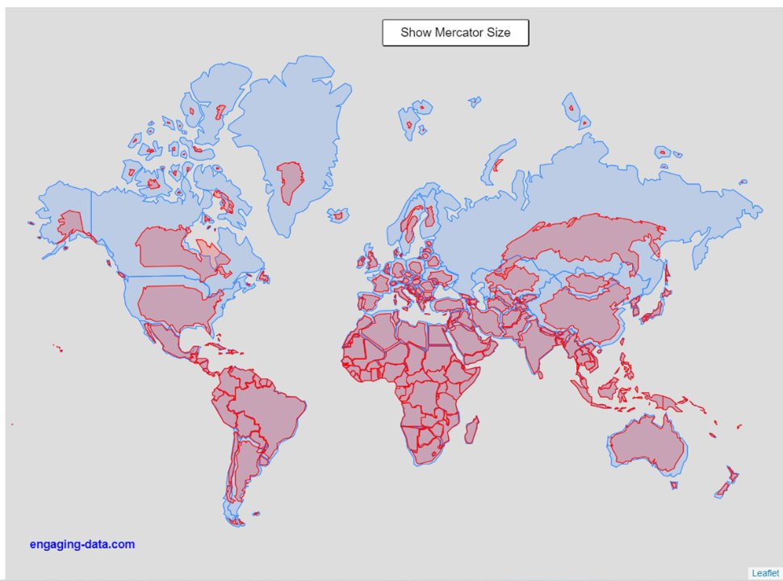
Geographical Data
Vectors
Generalised representation of the real world​
Composed of XY coordinates (Lon Lat) = vertices​
Based on Reference System (each one is different)
Points, lines or polygons​
Normally in .gpkg (Geopackage) format or .shp (Shapefile) format

Slide 8
Time for Python

Slide 9
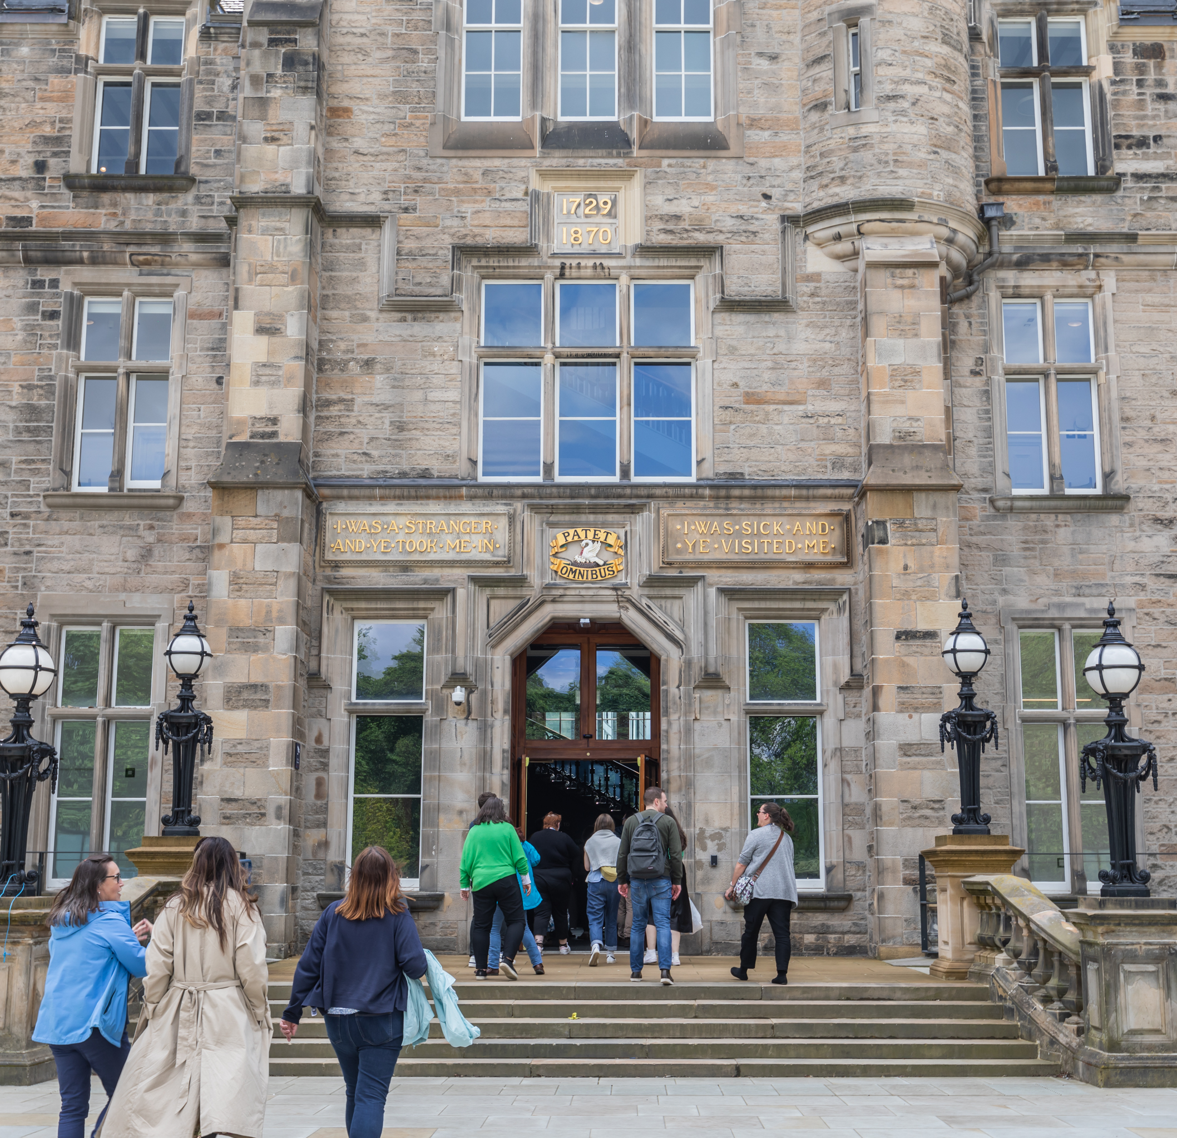
Questions?

